Slide 1
Advanced Predictive Analytics
1 | Decision Tree Regression
2 | Decision Tree classification
3 | Feature Importances
4 | Case Study: Customer Churn Prediction(Telecom Company)

Slide 2

Decision Trees

Slide 3
What are Decision Trees ?
Decision Tree is an algorithm used for building classification and regression models by representing it in the form of a tree structure.

Slide 4

Categorical Variable Decision Tree: Decision Tree which has categorical target variable then it called as categorical variable decision tree.
Types of Decision Trees
Continuous Variable Decision Tree: Decision Tree has continuous target variable then it is called as Continuous Variable Decision Tree.

Slide 5

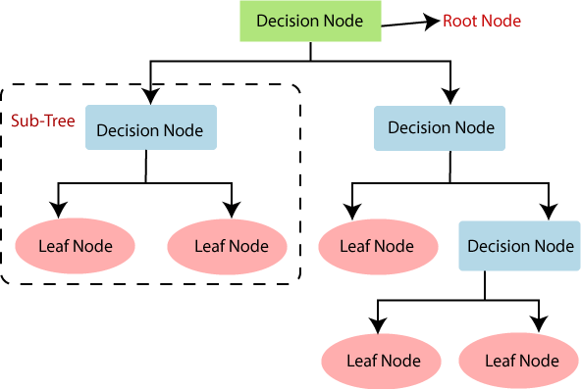
How does a Decision Tree look like ?
Root Node - The root node is the highest node in the tree structure and has no parent. This node is a global element and represents the entire message. It may have one or more child nodes but can never have sibling nodes or be repeating.
Internal Node - An internal node (also known as an inner node, inode for short, or branch node) is any node of a tree that has child nodes.
Leaf Nodes - An external node (also known as an outer node, leaf node, or terminal node) is any node that does not have child nodes.

Slide 6
Example of Decision Tree
Will the employee stay with
the company or leave ?
Environment Satisfaction > 2
YES
NO
Leave
Job Satisfaction > 2
YES
NO
Stay
Leave

Slide 7
Example of Decision tree
In the above slide , we discussed whether employee will stay or leave the organisation based on the information we have regarding Environment Satisfaction and Job Satisfaction .
We used Environment Satisfaction as the first criteria to decide whether he will stay or not .
But how do we decide this ?
How do we decide which variable to use first for the decision making ?

Slide 8
How does the attribute for the split is decided ?
The popular attribute selection measures are :
Entropy / Information Gain
Gini index
If dataset consists of “n” attributes like our dataset consists 35 attributes , then deciding which attribute to place at the root or at different levels of the tree as internal nodes is an essential step .
For solving this attribute selection problem, we have some criterion like
entropy/ information gain, Gini index, etc.

Slide 9
Entropy is the measurement of impurity or randomness in the data . In other words, how much variance the data has or unpredictability of a dataset.
Entropy
The value of entropy lies between 0 to 1 ,
Where entropy=0 means no impurity
And entropy = 1 means high impurity .
The variable with the lower entropy is used for split .

Slide 10
𝐻 = − ∑ 𝑝(𝑥) 𝑙𝑜𝑔 𝑝(𝑥)
Mathematical equation for entropy:
It is negative summation of probability times the log of probability of item x.
where p(x) is the probability of randomly picking an element of class.
Entropy
Employee count has single class : 1
It will have no randomness which means it has lowest entropy (almost 0).
Education has multiple classes : 2,1,4,3
It will have high randomness which means it has higher entropy.

Slide 11
Information Gain: Information gain (IG) measures how much “information” a feature gives us about the class. It Quantifies the quality of a split.​
The concept of entropy plays an important role in calculating Information Gain.
Information Gain
Information Gain = how much Entropy we removed
Higher information gain = More entropy removed
Decision tree at every stage selects the one that gives best information gain. When information gain is 0 means the feature does not divide the working set at all.
An attribute with low entropy and high Information gain will be used to split first.

Slide 12

HR of a company has picked up a sample of 300 employees with three variables:
Promotion in last 5 years (Yes/ No),
Number of Projects completed ( <=5/>5), and
Satisfaction Level (<=0.5/>0.5).
60 out of these 300 employees, left the company.
Now, HR team will create a model to predict who will leave the company in next 1 year. In this problem, HR needs to segregate employees who will leave the company in next 1 year based on highly significant predictor variables among all three.
This is where decision tree will help, it will segregate the employees based on all values of three variable and identify the variable, which creates the best homogeneous sets of employees (which are heterogeneous to each other).
Decision tree will identify the most significant variable and it’s value that gives best homogeneous sets of population. Now the question which arises is, how does it identify the variable and the split? To do this, decision tree uses various algorithms, which will be discussed in the following section.
Calculation Example of Entropy

Slide 13
Split on ‘Promotion in last 5 years’
Employees =
300
Left = 60
Split on ‘Projects completed’
Employees = 300
Left = 60
YES
NO
Employees =
100
Left = 8 (0.08)
Employees = 200
Left = 52 (0.26)
<= 5
> 5
Employees = 140
Left = 24 (0.17)
Employees = 160
Left = 36 (0.23)
Split on ‘Satisfaction Level’
Employees = 300
Left = 60
<= 0.5
> 0.5
Employees = 180
Left = 40 (0.22)
Employees =
120
Left = 20 (0.17)

Slide 14
Gini index says, if we select two items from a population at random then they must be of same class and probability for this is 1 if population is pure.
It works with categorical target variable “Success” or “Failure”.
The impurity (or purity) measure used in building decision tree in CART is Gini Index.
The decision tree built by CART algorithm is always a binary decision tree(each node will have only two child nodes).
Lower the value of GINI , higher the homogeneity.
Steps to Calculate Gini for a split:
Calculate Gini for sub-nodes, using formula sum of square of probability for success and failure (1- p^2+q^2).
Calculate Gini for split using weighted Gini score of each node of that split
Gini Index

Slide 15
Actual working of Gini Index
Employees = 300
Left = 60
Split on Promotion in last 5 years:
Here, p = 8/100 = 0.08
Gini for sub-node “Yes” =1- (0.08)^2+(1-0.08)^2 = 1-0.8528
Here, p = 52/200 = 0.26
Gini for sub-node “No” = 1-(0.26)^2+(1-0.26)^2 = 1-0.6152
NO
YES
Employees = 100
Left = 8 (0.08)
Employees = 200
Left = 52(0.26)
Weighted Gini for Promotion in last 5 years
= (100/300)* .1472 +(200/300)* .3848
= .3056
Split on Projects completed:
Here, p = 24/140 = 0.17
Gini for sub-node “<=5” = 1-(0.17)^2+(1-0.17)^2 =1- 0.7159 Here, p = 36/160 = 0.23
Gini for sub-node “>5” = 1-(0.23)^2+(1-0.23)^2 = 1-0.6513
Weighted Gini for Promotion in last 5 years
= (140/300)*0.2822 +(160/300)* 0.3432
= 0.3188
Employees = 300
Left = 60
<=5
>5
Employees = 140
Left = 24(0.17)
Employees = 160
Left = 36 (0.23)

Slide 16
Actual working of Gini Index
Split on Satisfaction Level:
Here, p = 20/120 = 0.17
Gini for sub-node “<=0.5” = 1-(0.17)^2+(1-0.17)^2 = 1-0.7222 Here, p = 40/180 = 0.22
Gini for sub-node “>0.5” = 1-(0.22)^2+(1-0.22)^2 = 1-0.6543
Employees = 300
Left = 60
Weighted Gini for Promotion in last 5 years
= (120/300)* .2822 +(180/300)* 0.3542
= 0.32060
<=0.05
>0.05
Employees = 120
Left = 20 (0.17)
Employees = 180
Left = 40 (0.22)
We can see that Gini score for Promotion in last 5 years is higher
than remaining variables, so the node split will take place on
Promotion in last 5 years.

Slide 17





Information Gain
By using information gain as a criterion, we try to estimate the
information
contained by each attribute. Look at the image below,\
A B
Information Gain and Entropy
These are 2 nodes A and B. We can easily explain node B as it requires less information because it has more of blue stars and can be classified as ‘Blue Star’ category, whereas in Node A it is equal mixture of both blue and red. Node B is called as a pure node/ homogenous node. Constructing a decision tree is all about finding attribute that returns the highest information gain (i.e., the most homogeneous branches).

Slide 18
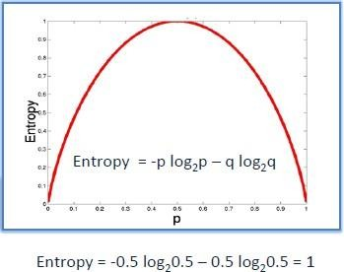
To measure the randomness or uncertainty of a random variable X is defined by Entropy. If the sample is completely homogeneous the entropy is zero and if the sample is an equally divided it has entropy of one. Entropy is calculated as,
Entropy = -p log2 p – q log2 q
Here p and q is probability of success and failure respectively in that node. The lesser the entropy, the better it is.
Entropy
Steps to calculate entropy for a split:
Calculate entropy of parent node
Calculate entropy of each individual node of split and calculate weighted average of all sub-nodes available in split.

Slide 19
Actual working on Entropy
Split on Promotion in last 5 years:
Entropy for ‘YES’ node = -(8/100) log2 (8/100) – (92/100) log2 (92/100) = 0.4022
and
For ‘NO’ node = -(52/200) log2 (52/200) – (148/200) log2 (148/200) = 0.8267
Weighted entropy of sub-nodes = (100/300)* 0.4022 + (200/300)* 0.8267 = 0.6852
Split on ‘Projects completed’
Entropy for ‘<= 5’ node = -(24/140) log2 (24/140) – (116/140) log2 (116/140) = 0.6610 and
For ‘> 5’ node = -(36/160) log2 (36/160) – (124/160) log2 (124/160) = 0.7692
Weighted entropy of sub-nodes = (140/300)* 0.6610 + (160/300)* 0.7692 = 0.7187

Slide 20
Actual working on Entropy
Split on ‘Satisfaction Level’
Entropy for ‘<= 0.5’ node = -(20/120) log2 (20/120) – (100/120) log2 (100/120) = 0.6500 and
For ‘> 0.5’ node = -(40/180) log2 (40/180) – (140/180) log2 (140/180) = 0.7642
Weighted entropy of sub-nodes = (120/300)* 0.6500 + (180/300)* 0.7642 = 0.7185
Above, we see that entropy for Split on Promotion in last 5 years is the lowest among all, so the tree will split on Promotion in last 5 years.
We can derive information gain from entropy as 1- Entropy.
Information Gain for Promotion in last 5 years = 1 – 0.6852 = 0.3148

Slide 21
Overfitting in Decision Tree
Environment
Satisfaction >
YES
NO
2
Job Satisfaction > 2
Job Involvement>3
YES
Job Level >3
YES
NO
NO
Job Involvement>3
LEAVE
LEAVE
YES
NO
YES
NO
Monthly Income > 4000
Monthly Income >4000
STAY
LEAVE
YES
STAY
YES
STAY

Slide 22
Hyperparameter Tuning
Hyperparameters are the parameters whose values are set before the model building begins, hyperparameters are crucial to the performance, speed, and quality of the machine learning models.
Some examples of common hyperparameters of decision tree include:
criterion : It defines the function to measure the quality of a split. E.g. Entropy, IG
max_features: It defines the no. of features to consider when looking for the best split.
max_depth: The max_depth parameter denotes maximum depth of the tree. It can take any integer value or None
min_samples_split: This tells above the minimum no. of samples reqd. to split an internal node.
min_samples_leaf: The minimum number of samples required to be at a leaf node.

Slide 23
Grid Search
Grid search is way to perform hyperparameter optimization.
It takes a dictionary i.e different values of all of the different hyperparameters that we want to test, and then feeds all of the
different combinations through the algorithm for us and then reports back to us with the optimal parameters.
max_features = [1, 3, 10,12,14] Criterion = ["gini", "entropy"] min_samples_split =[4,6,10,12,14]
min_samples_leaf =[2,4,5,7,8]
So, in above case Grid search will perform on every combination of the parameters.
i.e. it will perform (3*2*3*3) = 54 iterations and will give us the best parameter values.

Slide 24

Introduction To Bagging and Boosting

Slide 25

Bagging and Boosting
Bagging and Boosting are ensemble techniques in machine learning .
But what are ensemble techniques ?
ENSEMBLE LEARNING
Ensemble methods combine several classifiers to produce one model for better predictive performance.
In technical words, Ensemble learning is a machine learning paradigm where multiple models (often called “weak learners”) are trained to solve the same problem and combined to get better results.

Slide 26

Bagging and Boosting
These methods are designed to improve the stability and the accuracy of Machine Learning algorithms. Combinations of multiple classifiers produce a more reliable classification than a single classifier.
To use Bagging or Boosting you must select a base learner algorithm. For example, if we choose a classification tree, Bagging and Boosting would consist of a pool of trees.

Slide 27
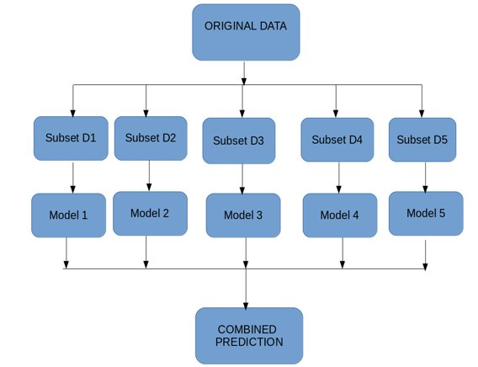
Bagging
In Bagging ,
Firstly , Multiple subsets are generated from the original dataset, with replacement.
Then , A base model (weak model) is created on each of these subsets. These models run in parallel and are independent of each other.
The final predictions are determined by combining the predictions from all the models.

Slide 28
How Bagging works ?
Our dataset has 1490 datapoints .
In the first step of bagging multiple subsets are created with replacement from the original dataset . Suppose from our dataset , 120 subsets are created .
Then a base learner i.e a machine learning algorithm will be applied to all these 120 subsets . Suppose decision tree is applied to all the subsets.
Then all the models will run parallelly and the final predictions will be made using the predictions of all the 120 models .
In our classification problem , the final predictions will be made by using majority voting , the most frequent class out of Yes and No will be selected .
For regression problems , the final predictions are made by taking the average of all the values predicted by all the trees .

Slide 29
Bootstrap Aggregation (Bagging)
Bagging is also known as Bootstrap Aggregation
Bootstrapping : Bootstrapping is a sampling technique. Out of the n samples available, k samples are chosen with replacement.
Aggregation : The predictions from the all the models are aggregated to make a final combined prediction. This aggregation can be done on the basis of predictions made or the probability of the predictions made by the bootstrapped individual models.
Bootstrapping the data plus using aggregate to make the decisions is BAGGING

Slide 30
Random Forest
Root node
Root node
Root node
Decision node
Decision node
Leaf
Leaf
Leaf
Leaf
Leaf
Leaf
Root node
Leaf
Leaf

Slide 31
Random Forest-
Bagging algorithm
Random forests are built from Decision trees , random forest is simply a collection of decision trees whose results are aggregated into one final result.
Random forest algorithm solves the problem of Decision trees of overfitting .
They are much more stable than Decision tree and is not biased .

Slide 32
How Random forest classifies a new data point ?
New Data point for prediction
Models | Prediction of Attrition
Decision Tree 1 | No
Decision Tree 2 | Yes
Decision Tree 3 | No
Decision Tree 4 | No
Decision Tree 5 . . . | Yes
Decision Tree n | No
Will the person attrite ?
YES | NO
2 | 4
Random forest model
Final Predicition :
The new person will not leave the organisation

Slide 33
Parameters of Random Forests
n_estimators: The number of trees in the forest. Default is 100. This is the number of trees you want to build before taking the maximum voting or averages of predictions. Higher number of trees gives you better performance but makes your code slower. You should choose as high value as your processor can handle because this makes your predictions stronger and more stable.
Criterion: It is the function to measure the quality of a split. Supported criteria are “gini” for the Gini impurity and “entropy” for the information gain

Slide 34
Parameters of Random Forests
max_depth: The maximum depth of the tree. If None, then nodes are expanded until all leaves are pure or until all leaves contain less than min_samples_split samples. While creating Decision Tress for its subset, each decision tree is created to its complete depth by default.
min_samples_leaf: The minimum number of samples required to be at a leaf node. A split point at any depth will only be considered if it leaves at least min_samples_leaf training samples in each of the left and right branches. This may have the effect of smoothing the model, especially in regression.

Slide 35
Advantages
of
Random
Forests
It has an effective method for estimating missing data and maintains accuracy when a large proportion of the data are missing.
It has methods for balancing errors in data sets where classes are imbalanced.
The capabilities of the above can be extended to unlabeled data, leading to unsupervised clustering, data views and outlier detection.

Slide 36
•It surely does a good job at classification but not as good as for regression problem as it does not give precise continuous nature predictions. In case of regression, it doesn’t predict beyond the range in the training data, and that they may over-fit data sets that are particularly noisy.
•Random Forest can feel like a black box approach for statistical modelers – you have very little control on what the model does. You can at best – try different parameters and random seeds.
Disadvantages
of
Random
Forests

Slide 37
Boosting works a little differently from Bagging .
Boosting is a sequential process, where each subsequent model attempts to correct the errors of the previous model. The succeeding models are dependent on the previous model.
Boosting

Slide 38
How Boosting works ?
Boosting works in the following steps :
1. All the data points of the dataset are given equal weights in the first step .
As our dataset have 1490 datapoint , each will be given a weight suppose , 1/1490
2. Then , the model is build and predictions are made .
3. Then the error is calculated i.e the difference between the predicted and the actual values .
4 . The data points which is incorrectly predicted is given a new and a higher weight . Another model is created , predictions are made and Errors are calculated .
Similarly, multiple models are created, each correcting the errors of the previous model.
The final model is the weighted mean of all the models.

Slide 39
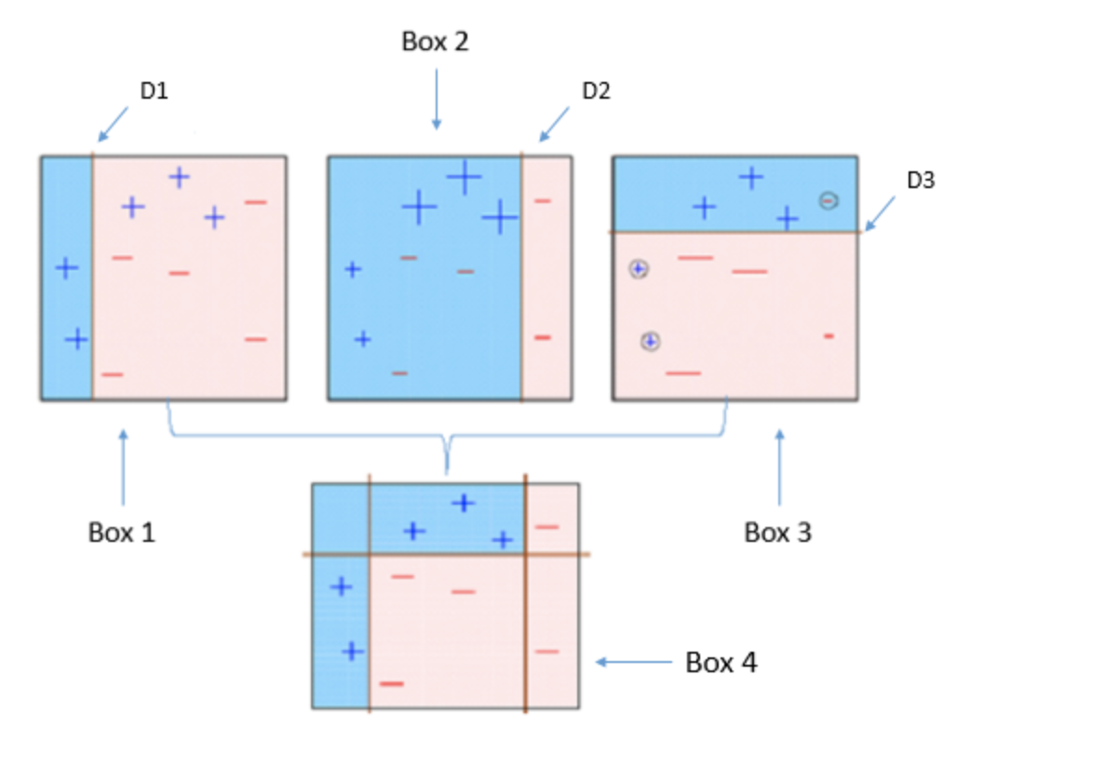
Let's see the working of Boosting with a diagram
In this diagram , we have two classes + and – and D1 is our first model , where all the data points are assigned equal weights .
In D1 three + datapoints are misclassified (as seen in the D1 box)
So, while creating second model these three + datapoints are assigned higher weights and we can see in D2 , after assigning higher weights they are correclty classified .
But again in D2 I.e model 2 , three – datapoints are incorrectly classified so they will be assigned with higher weights for proper classification
In D3 the previously incorreclty classifed points are classified correclty .
In the D4 model , all the previous models are combined to form a strong correct prediction

Slide 40
XG Boost also known as “Extreme Gradient Boosting”
The main aim of this algorithm is to increase the speed and efficiency of computation.
Features of the model :
Regularization: This is considered to be a dominant factor of the algorithm.Regularization is a technique that is used to get rid of overfitting of the model.
Cross-Validation: We use cross-validation by importing the function from sklearn but XGboost is enabled with inbuilt CV function .
Execution Speed : XGBoost performs extreme optimization in terms of RAM utilization , CPU core utilization and cache utilization.
XG Boost

Slide 41
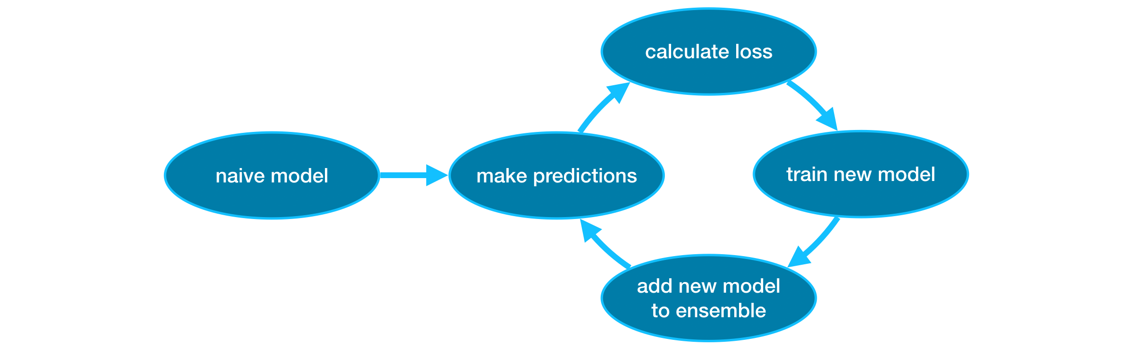
XG Boost
XG Boost

Slide 42
Create decision tree
Decide the set/value of hyper parameters to be used
Use grid search
For every possible combination based on the grid provided by the modeler, create one model
Evaluate the model perf wrt the hyperparameter value combination
Choose the combination that delivered the model with highest perf
Using the final values, train your model

Slide 43
Decision tree with default
HP values
1. root Node,2.X1 decision,3.Entropy,4.Gini
Optimize it’s hypeparameter
value
Use GS and create many more DT to identify the best one

Slide 44


